Slide 1
Python Data Structures
Università di Modena e Reggio Emilia
Prof. Nicola Bicocchi (nicola.bicocchi@unimore.it)

Slide 2
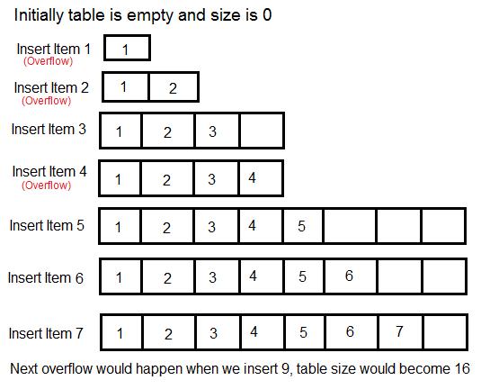
Resizable Array ~O(n)

Slide 3
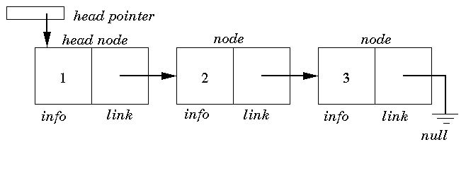
Linked List ~O(n)

Slide 4
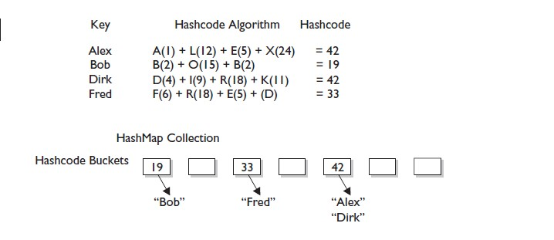
Hash Table ~O(1)

Slide 5
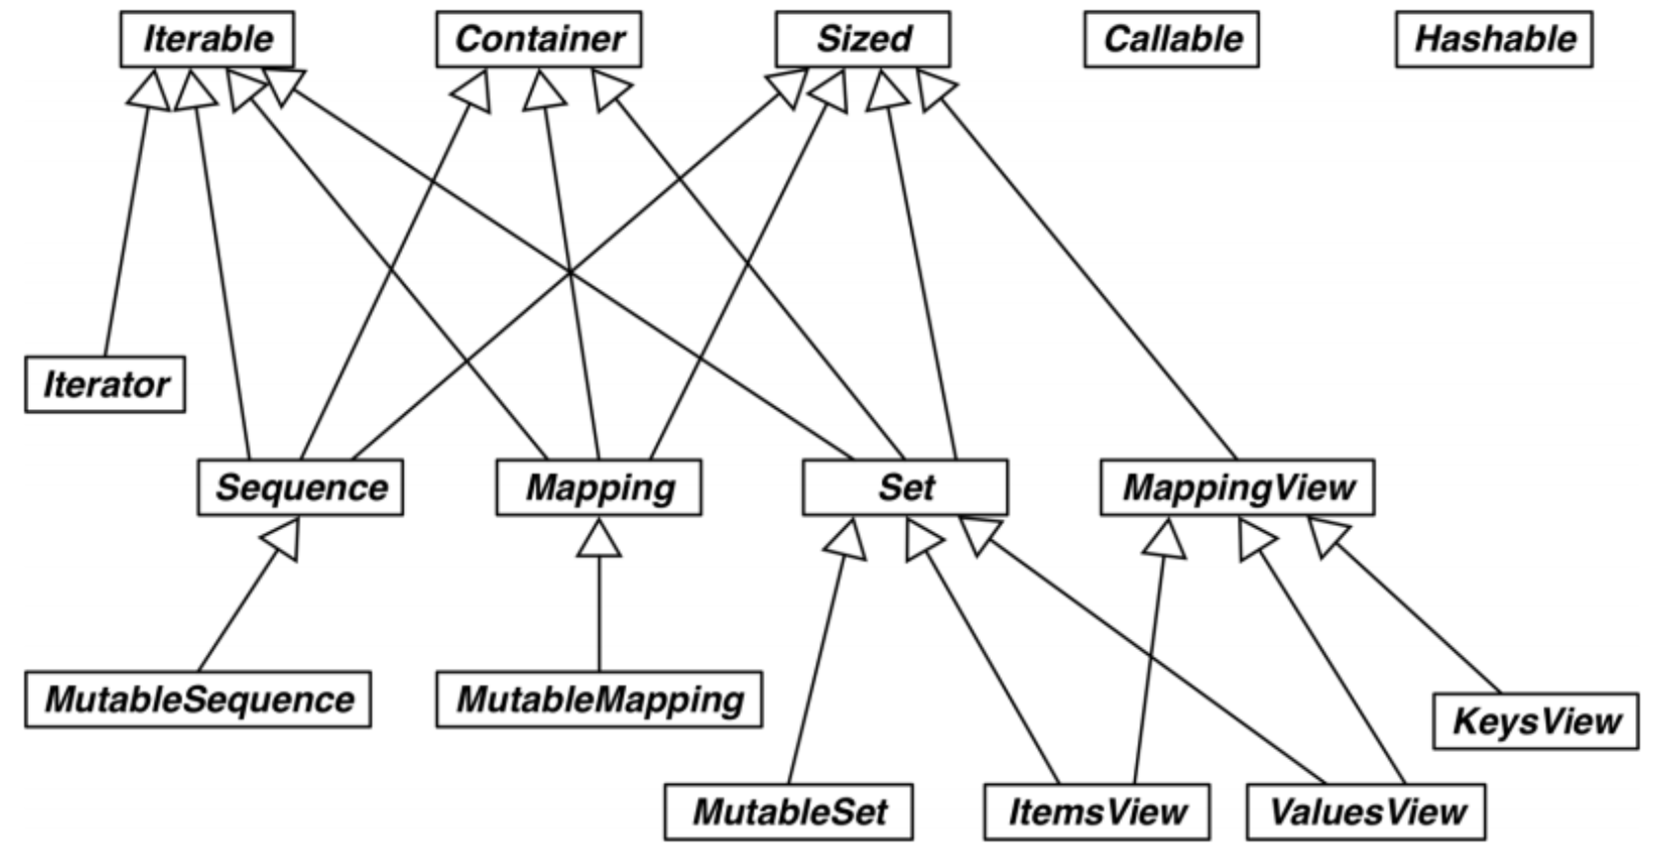
Collections Hierarchy

Slide 6
Collections Hierarchy
Iterable, Container, and Sized: Every collection should either inherit from these classes (collections.abc package) or at least implement compatible protocols. Iterable supports iteration with __iter__, Container supports the in operator with __contains__, and Sized supports len() with __len__.
Iterator: Iterator subclasses Iterable. An iterator object must implement two special methods, __iter__() and __next__(), collectively called the iterator protocol.
Sequence, Mapping, and Set: These are the main immutable collection types, and each has a mutable subclass.
MappingView: Objects returned from the mapping methods .items(), .keys(), and .values() inherit from ItemsView, ValuesView, and ValuesView, respectively. The first two also inherit the rich interface of Set.
Callable and Hashable: These ABCs are not so closely related to collections, but collections.abc was the first package to define ABCs in the standard library, and these two were deemed important enough to be included. Their main use is to support the insinstance built-in as a safe way of determining whether an object is callable or hashable.

Slide 7
Iterable
An iterable object is any object capable of returning its members one at a time, permitting it to be iterated over in a for-loop.
Familiar examples of iterables include lists, tuples, dictionaries, sets, and strings. Indeed, any such sequence can be iterated over in a for-loop.
It is also possible to have an iterable that “generates” each one of its members upon iteration without storing all of its members in memory at once.
numbers = [1, 2, 3, 4] for n in numbers: print(n)
numbers = (1, 2, 3, 4) for n in numbers: print(n)
map = {1 : 'a', 2 : 'b’,
3 : 'c', 4: 'd'} for k, v in map.items(): print(k, v)
string = 'Hello World!' for c in string: print(c)

Slide 8
Functions acting on iterables
list, tuple, dict, set: construct a list, tuple, dictionary, or set, respectively, from the contents of an iterable
sum: sum the contents of an iterable.
sorted: return a list of the sorted contents of an iterable
any: returns True and ends the iteration immediately if bool(item) was True for any item in the iterable.
all: returns True only if bool(item) was True for all items in the iterable.
max: return the largest value in an iterable.
min: return the smallest value in an iterable.

Slide 9
Functions acting on iterables
>>> list("I am a cow")
['I', ' ', 'a', 'm', ' ', 'a', ' ', 'c', 'o', 'w']
>>> sum([1, 2, 3])
6
>>> sorted("gheliabciou")
['a', 'b', 'c', 'e', 'g', 'h', 'i', 'i', 'l', 'o', 'u']
>>> any((0, None, [], 0))
False
>>> all([1, (0, 1), True, "hi"])
True
>>> max((5, 8, 9, 0))
9
>>> min("hello")
'e'

Slide 10
Iterable and Iterator
Every iterator is an iterable, but not every iterable is an iterator.
An iterable is an object that can be iterated over but does not necessarily have all the machinery of an iterator. For example, sequences (e.g lists, tuples, and strings) and other containers (e.g. dictionaries and sets) do not keep track of their own state of iteration. Thus you cannot call next on one of these outright.
An iterator object stores its current state of iteration and “yields” each of its members in order, on demand via next, until it is exhausted. As we’ve seen, a generator is an example of an iterator.
my_list = [4, 7, 0, 3] my_iter = iter(my_list) print(next(my_iter)) print(my_iter.__next__()) print(next(my_list))
# Output
4
7
TypeError: 'list' object is not an iterator

Slide 11
Data Structures
List
resizable array
mutable
keep insertion order
allows duplicates
Tuple
record
immutable, mutable items
keep insertion order
allows duplicates
Set
hash table
mutable, immutable items
unordered
no duplicates
Dictionary
hash table
mutable
unordered
no duplicates in keys

Slide 12
Lists

Slide 13
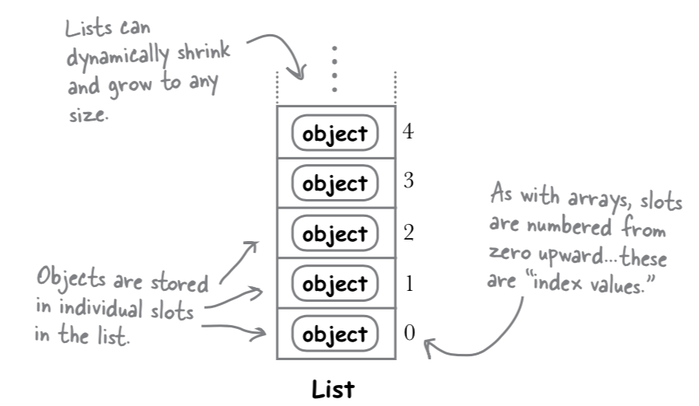
Lists
Lists are mutable. They can grow and shrink by adding and removing objects as needed. It’s also possible to change any object stored in any slot.
Lists do not need be homogeneous. A single list may contain data types like Integers, Strings, as well as Objects.
Lists are mutable, and hence, they can be altered even after their creation.
List are ordered and have a definite count. The elements in a list are indexed according to a definite sequence and the indexing of a list is done with 0 being the first index.

Slide 14
List
A list is created by placing all the items (elements) inside square brackets [], separated by commas.
It can have any number of items and they may be of different types (integer, float, string etc.).
A list can also have another list as an item.
# empty list
my_list = []
# list of integers
my_list = [1, 2, 3]
# list with mixed data types
my_list = [1, "Hello", 3.4]
# nested list
my_list = ["mouse", [8, 4, 6], ['a']]

Slide 15
Indexing
We can use the index operator [] to access an item in a list.
Indices start at 0. So, a list having 5 elements will have an index from 0 to 4.
Trying to access indexes other than these will raise an IndexError.
The index must be an integer.
my_list = ['p', 'r', 'o', 'b', 'e']
# Output: p
print(my_list[0])
# Output: e
print(my_list[4])
# Nested indexing
my_list = ["Happy", [2, 0, 1, 5]]
print(my_list[0][1])
print(my_list[1][3])
# Error! Only integer can be used for indexing
print(my_list[4.0])

Slide 16
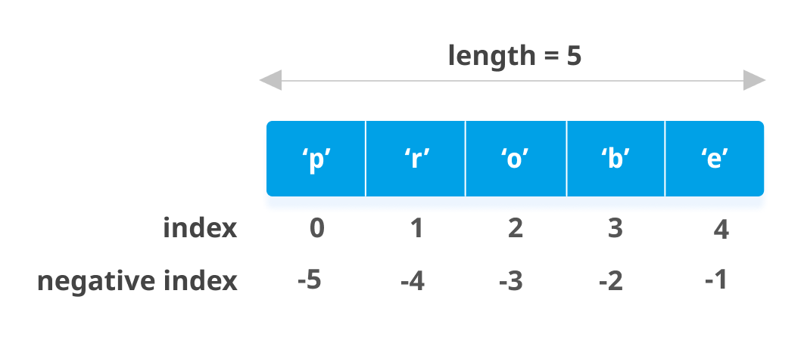
Negative Indexing
Negative indexing is allowed
The index of -1 refers to the last item, -2 to the second last item and so on.
# Negative indexing
l = ['p','r','o','b','e']
print(l[-1])
print(l[-5])
# Output
e
p

Slide 17
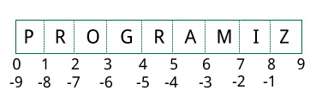
Slicing
We can access a range of items in a list by using the slicing operator :(colon).
Slices are partial copies of the original list
my_list = ['p','r','o','g','r','a','m','i','z']
# elements 3rd to 5th
print(my_list[2:5])
# elements beginning to 4th
print(my_list[:-5])
# elements 6th to end
print(my_list[5:])
# elements beginning to end
print(my_list[:])
['o', 'g', 'r']
['p', 'r', 'o', 'g']
['a', 'm', 'i', 'z']
['p', 'r', 'o', 'g', 'r', 'a', 'm', 'i', 'z']

Slide 18
Changing elements
Lists are mutable, meaning their elements can be changed unlike string or tuple.
We can use the assignment operator (=) to change an item or a range of items.
It is possible to change entire slices eventually
my_list = [2, 4, 6, 8]
# change the 1st item
my_list[0] = 1
print(my_list)
# change 2nd to 4th items
my_list[1:4] = [3, 5, 7]
print(my_list)
# Output
[1, 4, 6, 8]
[1, 3, 5, 7]

Slide 19
Adding elements
We can add one item at the end of a list using the append() method
We can add one item in a specific position using the insert() method
We can add a (flat) group of items using the extend() method
# Appending and Extending lists
my_list = [3, 5]
my_list.append(7)
print(odd)
my_list.insert(0, 1)
print(odd)
my_list.append([9, 11, 13])
print(odd)
my_list.extend([17, 19, 23])
print(odd)
# Output
[3, 5, 7]
[1, 3, 5, 7]
[1, 3, 5, 7, [9, 11, 13]]
[1, 3, 5, 7, [9, 11, 13], 17, 19, 23]

Slide 20
Adding elements
We can also use + operator to combine two lists. This is also called concatenation.
The * operator repeats a list for the given number of times.
# Concatenating and repeating
my_list = [1, 3, 5]
print(my_list + [9, 7, 5])
print([‘abc’] * 3)
# Output
[1, 3, 5, 9, 7, 5]
[‘abc’, ‘abc’, ‘abc’]

Slide 21
Deleting elements
We can delete one or more items from a list using the keyword del.
del can even delete the list entirely.
# Deleting list items
my_list = ['p', 'r', 'o', 'b', 'l', 'e', 'm']
# delete one item
del my_list[2]
print(my_list)
# delete multiple items
del my_list[1:5]
print(my_list)
# delete entire list
del my_list
print(my_list)
# Output
['p', 'r', 'b', 'l', 'e', 'm']
['p', 'm']
Traceback (most recent call last):
File "<string>", line 18, in <module>
NameError: name 'my_list' is not defined

Slide 22
Removing elements
We can use remove() method to remove the given item or pop() method to remove an item at the given index.
The pop() method removes and returns the last item if the index is not provided.
Useful for implementing lists as stacks (first in, last out data structure).
We can also use the clear() method to empty a list.
my_list = ['p','r','o','b','l','e','m’]
# Output: ['r', 'o', 'b', 'l', 'e', 'm']
my_list.remove('p')
# Output: 'o'
print(my_list.pop(1))
# Output: ['r', 'b', 'l', 'e', 'm']
print(my_list)
# Output: 'm'
print(my_list.pop())
# Output: ['r', 'b', 'l', 'e']
print(my_list)
# Output: []
my_list.clear()

Slide 23
Iterating Through a List
# Python3 code to iterate over a list
list = [1, 3, 5, 7, 9]
for i in list:
print(i)
# Python3 code to iterate over a list (by index)
list = [1, 3, 5, 7, 9]
length = len(list)
for i in range(length):
print(list[i])

Slide 24
Tuples

Slide 25
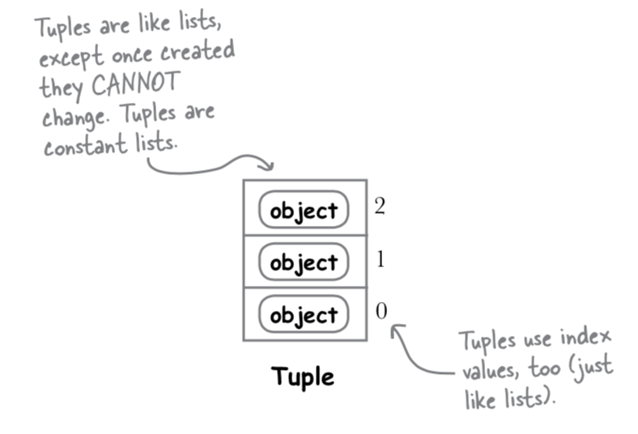
Tuples
A tuple is a collection of objects much like a list. The sequence of values stored in a tuple can be of any type, and they are indexed by integers.
Tuples are immutable. A tuple cannot change once it is assigned.
Eventually, we can change its internal items, if they are mutable (e.g., a list contained in a tuple).

Slide 26
Tuples
A tuple is created by placing all the items (elements) inside parentheses (), separated by commas. The parentheses are optional, however, it is a good practice to use them.
A tuple can have any number of items and they may be of different types (integer, float, list, string, etc.).
# empty tuple
my_tuple = ()
print(my_tuple)
# tuple having integers
my_tuple = (1, 2, 3)
print(my_tuple)
# tuple with mixed datatypes
my_tuple = (1, "Hello", 3.4)
print(my_tuple)
# nested tuple
my_tuple = ("mouse", [8, 4, 6], (1, 2, 3))
print(my_tuple)
# Output
()
(1, 2, 3)
(1, 'Hello', 3.4)
('mouse', [8, 4, 6], (1, 2, 3))

Slide 27
Tuples with one element
Creating a tuple with one element is a bit tricky.
Having one element within parentheses is not enough. A trailing comma to indicate that it is a tuple is required.
my_tuple = ("hello")
print(type(my_tuple))
# Creating a tuple having one element
my_tuple = ("hello",)
print(type(my_tuple))
# Parentheses is optional
my_tuple = "hello",
print(type(my_tuple))
# Output
<class 'str'>
<class 'tuple'>
<class 'tuple'>

Slide 28
Access Tuple Elements
There are various ways in which we can access the elements of a tuple.
Indexing
Negative Indexing
Slicing
my_tuple = ('p', 'e', 'r', 'm', 'i', 't') # indexing print(my_tuple[0]) print(my_tuple[5]) # negative indexing print(my_tuple[-1]) # slicing print(my_tuple[1:4])
# Output
p
t
t
('e', 'r', 'm')

Slide 29
Access Tuple Elements
Unlike lists, tuples are immutable. Elements of a tuple cannot be changed once they have been assigned.
However, if the element is itself a mutable data type like list, its nested items can be changed.
We can also assign a tuple to different values (reassignment).
my_tuple = (4, 2, 3, [6, 5])
my_tuple[1] = 9
TypeError: 'tuple' object does not support item assignment
# However… my_tuple[3][0] = 9 print(my_tuple) # Tuples can be reassigned my_tuple = ('n', 'i', 'c', 'o', 'l', 'a') print(my_tuple)
# Output
(4, 2, 3, [9, 5])
('n', 'i', 'c', 'o', 'l', 'a')

Slide 30
Access Tuple Elements
We cannot change the elements in a tuple. It means that we cannot delete or remove items from a tuple.
Deleting a tuple entirely, however, is possible using the keyword del.
my_tuple = ('n', 'i', 'c', 'o', 'l', 'a’)
del my_tuple[3]
# TypeError: 'tuple' object doesn't support item deletion
del my_tuple
print(my_tuple)
# NameError: name 'my_tuple' is not defined

Slide 31
Other Tuple Operations
We can test if an item exists in a tuple or not, using the keyword in.
We can use a for loop to iterate through each item in a tuple.
my_tuple = ('a', 'p', 'p', 'l', 'e',)
print('a' in my_tuple)
print('b' in my_tuple)
print('g' not in my_tuple)
# iterate through a tuple
for name in ('John', 'Kate'):
print("Hello", name)
# Output
True
False
True
Hello John
Hello Kate

Slide 32
Advantages of Tuple over List
Since tuples are quite similar to lists, both of them are used in similar situations. However, there are certain advantages of implementing a tuple over a list. Below listed are some of the main advantages:
We generally use tuples for heterogeneous (different) data types and lists for homogeneous data types.
Since tuples are immutable, iterating through a tuple is faster than with list.
Tuples that contain immutable elements can be used as a key for a dictionary. With lists, this is not possible.
If you have data that doesn't change, implementing it as tuple will guarantee that it remains write-protected.

Slide 33
Sets

Slide 34
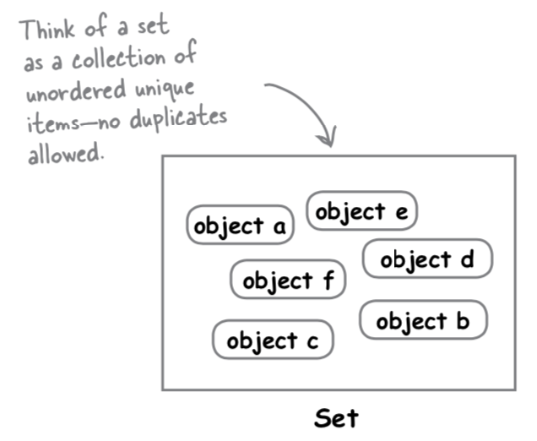
Sets
A set is an unordered collection data type, mutable and has no duplicate elements.
Set items must be immutable (e.g., lists are not allowed)
The Set class represents the mathematical notion of a set.
The major advantage of using a set, as opposed to a list, is that it has a highly optimized method for checking whether a specific element is contained in the set.
Sets are based on a data structure known as a hash table. Since sets are unordered, we cannot access items using indexes like we do in lists.

Slide 35
Constructing Sets
A set is created by placing all the items (elements) inside curly braces {}, separated by comma, or by using the built-in set() function.
It can have any number of items and they may be of different types (integer, float, tuple, string etc.).
A set cannot have mutable elements like lists, sets or dictionaries as its elements.
# set of integers
my_set = {1, 2, 3}
print(my_set)
# set of mixed datatypes
my_set = {1.0, "Hello", (1, 2, 3)}
print(my_set)
# set from list
my_set = set([1, 2, 3, 2])
print(my_set)
# inserting mutable elements
my_set = {1, 2, [3, 4]}
# Output
{1, 2, 3}
{1.0, 'Hello', (1, 2, 3)}
{1, 2, 3}
TypeError: unhashable type: 'list'

Slide 36
Constructing Sets
# Distinguish set and dictionary while creating empty set
# initialize a with {}
a = {}
# check data type of a
print(type(a))
# initialize a with set()
a = set()
# check data type of a
print(type(a))
# Output
<class 'dict'>
<class 'set'>

Slide 37
Modifying Sets
Sets are mutable. However, since they are unordered, indexing has no meaning.
We cannot access or change an element of a set using indexing or slicing. Set data type does not support it.
We can add a single element using the add() method, and multiple elements using the update() method.
The update() method can take tuples, lists, strings or other sets as its argument. In all cases, duplicates are avoided.
# initialize my_set
my_set = {1, 3}
print(my_set)
# add an element
my_set.add(2)
print(my_set)
# add multiple elements
my_set.update([2, 3, 4])
print(my_set)
# Output
{1, 3}
{1, 2, 3}
{1, 2, 3, 4}

Slide 38
Removing elements
A particular item can be removed from a set using the methods discard() and remove().
The only difference between the two is that the discard() function leaves a set unchanged if the element is not present in the set. On the other hand, the remove() function will raise an error in such a condition (if element is not present in the set).
# initialize my_set
my_set = {1, 3, 4, 5, 6}
print(my_set)
# discard an element
my_set.discard(4)
print(my_set)
# remove an element
my_set.remove(6)
print(my_set)
# discard an element not present
my_set.discard(4)
print(my_set)
# output
{1, 3, 4, 5, 6}
{1, 3, 5, 6}
{1, 3, 5}
KeyError: 4

Slide 39
Set operations
Sets can be used to carry out mathematical set operations like union, intersection, difference and symmetric difference.
A = {1, 2, 3, 4, 5}
B = {4, 5, 6, 7, 8}
print(A | B) # union
print(A & B) # intersection
print(A - B) # difference
print(A ^ B) # simmetric difference
# Output
{1, 2, 3, 4, 5, 6, 7, 8}
{4, 5}
{1, 2, 3}
{1, 2, 3, 6, 7, 8}

Slide 40
Set membership
We can test if an item exists in a set or not, using the in keyword.
Sets are significantly faster than lists when it comes to determining if an object is present in the set (as in x in s), but are slower than lists when it comes to iterating over their contents.
You can use the timeit module to see which is faster for your situation.
t = timeit.timeit("'a' in {'a', 'b', 'c', 'd', 'e', 'f', 'g', 'h', 'i'}", number=1000000)
t = timeit.timeit("'a' in ['a', 'b', 'c', 'd', 'e', 'f', 'g', 'h', 'i']", number=1000000)
t = timeit.timeit("'i' in {'a', 'b', 'c', 'd', 'e', 'f', 'g', 'h', 'i'}", number=1000000)
t = timeit.timeit("'i' in ['a', 'b', 'c', 'd', 'e', 'f', 'g', 'h', 'i']", number=1000000)
# Output
0.033
0.030
0.032
0.184

Slide 41
Frozen Sets
Frozenset is a new class that has the characteristics of a set, but its elements cannot be changed once assigned. While tuples are immutable lists, frozensets are immutable sets.
Sets being mutable are unhashable, so they can't be used as dictionary keys. On the other hand, frozensets are hashable and can be used as keys to a dictionary.
Frozensets can be created using the frozenset() function.
s1 = frozenset([1, 2, 3, 4])
s2 = frozenset([3, 4, 5, 6])
s1.add(3)
AttributeError: 'frozenset' object has no attribute 'add'

Slide 42
Dictionaries

Slide 43
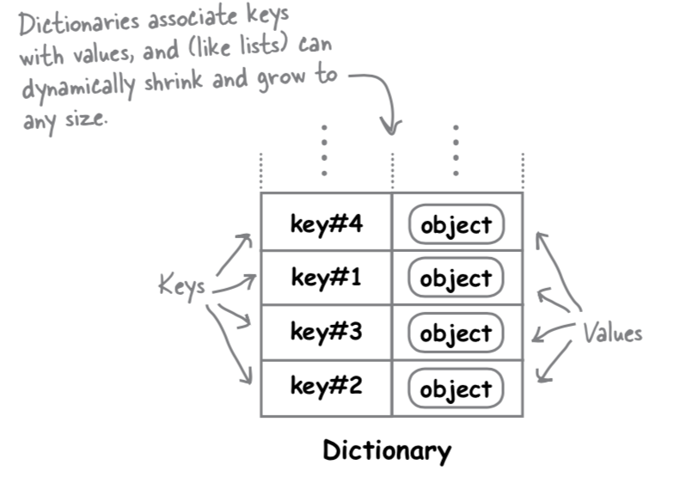
Dictionaries
A dictionary is an unordered collection of key/value pairs.
Each unique and immutable key has a value associated with it in the dictionary.
Dictionaries can have any number of pairs. The values associated with a key can be any object.
Dictionaries are unordered and mutable.
The order in which key/value pairs are added to a dictionary is not maintained by the interpreter, and has no meaning.

Slide 44
Dictionaries
# Creating a Dictionary with Integer Keys
dict = {1: 'Geeks', 2: 'For', 3: 'Geeks'}
print(dict)
# Creating a Dictionary with Mixed keys
dict = {'Name': 'Geeks', 1: [1, 2, 3, 4]}
print(dict)
# Output
{1: 'Geeks', 2: 'For', 3: 'Geeks'}
{1: [1, 2, 3, 4], 'Name': 'Geeks'}

Slide 45
Accessing Elements
While indexing is used with other data types to access values, a dictionary uses keys. Keys can be used either inside square brackets [] or with the get() method.
If we use the square brackets [], KeyError is raised in case a key is not found in the dictionary. On the other hand, the get() method returns None if the key is not found.
# get vs [] for retrieving elements
my_dict = {'name': 'Jack', 'age': 26}
print(my_dict['name’])
print(my_dict.get('age’))
print(my_dict.get('address'))
print(my_dict['address’])
# Output
Jack
26
None
KeyError: 'address'

Slide 46
Accessing Elements
Dictionaries are mutable. We can add new items or change the value of existing items using an assignment operator.
If the key is already present, then the existing value gets updated. In case the key is not present, a new (key: value) pair is added to the dictionary.
# Changing and adding
my_dict = {'name': 'Jack', 'age': 26}
my_dict['age'] = 27
print(my_dict)
my_dict['address'] = 'Downtown'
print(my_dict)
# Output
{'name': 'Jack', 'age': 27}
{'name': 'Jack', 'age': 27, 'address': 'Downtown'}

Slide 47
Removing Elements
We can remove a particular item in a dictionary by using the pop() method. This method removes an item with the provided key and returns the value.
The popitem() method can be used to remove and return an arbitrary (key, value) item pair from the dictionary.
All the items can be removed at once, using the clear() method.
We can also use the del keyword to remove individual items or the entire dictionary itself.
squares = {1: 1, 2: 4, 3: 9, 4: 16, 5: 25}
# remove a particular item, returns its value
print(squares.pop(4))
# remove an arbitrary item, return (key,value)
print(squares.popitem())
print(squares)
# remove all items
squares.clear()
print(squares)
# Output
16
(5, 25)
{1: 1, 2: 4, 3: 9}
{}

Slide 48
Other Dictionary Operations
We can test if a key is in a dictionary or not using the keyword in.
Notice that the membership test is only for the keys and not for the values.
We can iterate through both keys and key:value pairs using a for loop.
squares = {1: 1, 3: 9, 5: 25, 7: 49, 9: 81}
# membership tests for key only
print(1 in squares)
print(2 not in squares)
print(49 in squares)
# Iterating through keys
for i in squares:
print(squares[i])
# Iterating through keys and values
for k, v in squares.items():
print(k, v)
# Output
True
True
False

Slide 49
Comprehension Expressions

Slide 50
Unpacking and Enumerating
Python provides some syntactic “tricks” for working with iterables: unpacking iterables and enumerating iterables. Useful for writing clean, readable code.
Writing clean, readable code leads to bug-free algorithms that are easy to understand. Furthermore, these tricks will also facilitate the use of other features, like comprehension-statements.

Slide 51
Unpacking iterables
# assigning a list to variables using iterable unpacking
my_list = [7, 9, 11]
x, y, z = my_list
grades = [("Ashley", 93), ("Brad", 95), ("Cassie", 84)]
# for loop without unpacking
for entry in grades:
print(entry)
# for loop with unpacking
for name, grade in grades:
print(name)
print(grade)
print("\n")

Slide 52
Enumerating iterables
The built-in enumerate function allows us to iterate over an iterable, while keeping track of the iteration count
The enumerate function accepts an iterable as an input, and returns a new iterable that produces a tuple of the iteration-count and the corresponding item from the original iterable.
Thus the items in the iterable are being enumerated.
# basic usage of `enumerate`
for entry in enumerate(‘abcd’):
print(entry)
(0, 'a')
(1, 'b')
(2, 'c')
(3, 'd')

Slide 53
Enumerating iterables
# track which entries of an iterable store the value `None`
# without enumeration
none_indices = []
iter_cnt = 0
for item in [2, None, -10, None, 4, 8]:
if item is None:
none_indices.append(iter_cnt)
iter_cnt = iter_cnt + 1
# track which entries of an iterable store the value `None`
# with enumeration
none_indices = []
for iter_cnt, item in enumerate([2, None, -10, None, 4, 8]):
if item is None:
none_indices.append(iter_cnt)

Slide 54
Generators
A generator is a special kind of iterator, which stores the instructions for how to generate each of its members, in order, along with its current state of iterations.
It generates each member, one at a time, only as it is requested via iteration.
# start: 1 (included) # stop: 10 (excluded) # step: 2
for i in range(1, 10, 2):
print(i)
# prints: 1.. 3.. 5.. 7.. 9

Slide 55
Generators
# start: 2 (included) # stop: 7 (excluded) # step: 1 (default)
for i in range(2, 7):
print(i)
# prints: 2.. 3.. 4.. 5.. 6
# start: 1 (included) # stop: 10 (excluded) # step: 2
for i in range(1, 10, 2):
print(i)
# prints: 1.. 3.. 5.. 7.. 9
# A very common use case!
# start: 0 (default, included) # stop: 5 (excluded) # step: 1 (default)
for i in range(5):
print(i)
# prints: 0.. 1.. 2.. 3.. 4

Slide 56
Generator Comprehension
A generator comprehension is a single-line specification for defining a generator. It is absolutely essential to learn this syntax in order to write simple and readable code.
(<expression> for <var> in <iterable> [if <condition>]) specifies the general form for a generator comprehension. This produces a generator, whose instructions for generating its members are provided within the parenthetical statement.
(<expression> for <var> in <iterable>) is also valid.
for <var> in <iterable>:
if bool(<condition>):
yield <expression>
for <var> in <iterable>:
if bool(<condition>):
yield <expression>

Slide 57
Generator Comprehension
example_gen = (i/2 for i in [0, 9, 21, 32])
for item in example_gen:
print(item)
# 0.0
# 4.5
# 10.5
# 16.0
example_gen = ((i, i**2, i**3) for i in range(5))
for item in example_gen:
print(item)
# (0, 0, 0)
# (1, 1, 1)
# (2, 4, 8)
# (3, 9, 27)
# (4, 16, 64)

Slide 58
Generator Comprehension
example_gen = (("apple" if i < 3 else "pie") for i in range(6))
for item in example_gen:
print(item)
# 'apple'..
# 'apple'..
# 'apple'..
# 'pie'..
# 'pie'..
# 'pie'

Slide 59
Consuming Generators
We can feed a generator to any function that accepts iterables. For instance, we can feed it to the built-in sum function, which sums the contents of an iterable. This computes the sum of the sequence of numbers without ever storing the full sequence of numbers in memory.
You must redefine the generator if you want to iterate over it again; fortunately, defining a generator requires very few resources, so this is not a point of concern.
gen = (i**2 for i in range(10))
sum(gen)
# computes the sum 0 + 1 + 4 + 9 + 25 + ... + 81
285
# computes the sum of ... nothing!
# `gen` has already been consumed!
sum(gen)
0

Slide 60
Using generator comprehensions on the fly
A generator comprehension can be specified directly as an argument to a function, wherever a single iterable is expected as an input to that function.
# providing generator expressions as arguments to functions
# that operate on iterables
list(i**2 for i in range(10))
[0, 1, 4, 9, 16, 25, 36, 49, 64, 81]
all(i < 10 for i in [1, 3, 5, 7])
True
", ".join(str(i) for i in [10, 200, 4000, 80000])
'10, 200, 4000, 80000'

Slide 61
Iterating over generators (next)
The built-in function next allows you manually “request” the next member of a generator, or more generally, any kind of iterator. Calling next on an exhausted iterator will raise a StopIteration signal.
short_gen = (i/2 for i in [1, 2, 3])
next(short_gen)
0.5
next(short_gen)
1.0
next(short_gen)
1.5
next(short_gen)
StopIteration
Traceback (most recent call last)

Slide 62
List & Tuple Comprehensions
Using generator comprehensions to initialize lists is so useful that Python actually reserves a specialized syntax for it, known as the list comprehension. A list comprehension is a syntax for constructing a list, which exactly mirrors the generator comprehension syntax:
[<expression> for <var> in <iterable> {if <condition>}]
List comprehension produces the exact same result as feeding the list function a generator comprehension. However, using a list comprehension is slightly more efficient than is feeding the list function a generator comprehension.
# creating a list using a comprehension expression
>>> [i**2 for i in range(10)]
[0, 1, 4, 9, 16, 25, 36, 49, 64, 81]
# creating a tuple using a comprehension expression
>>> tuple(i**2 for i in range(5))
(0, 1, 4, 9, 16)

Slide 63
List & Tuple Comprehensions
# Select all words containing the char ‘o’ OR ‘O’
word_collection = ['Python', 'Like', 'You', 'Mean', 'It’]
# without list comprehension (4 lines)
words_with_o = []
for word in word_collection:
if "o" in word.lower():
words_with_o.append(word)
# with list comprehension (1 line)
words_with_o = [word for word in word_collection if "o" in word.lower()]

Slide 64
List & Tuple Comprehensions
# Skip all non-lowercased letters (including punctuation)
# Append 1 if lowercase letter is "o"
# Append 0 if lowercase letter is not "o"
s = 'Hello. How Are You?’
# without comprehension
out = []
for i in s:
if i.islower():
out.append(1 if i is "o" else 0)
# with comprehension
out = [(1 if letter == 'o' else 0) for letter in s if letter.islower()]

Slide 65
Dictionary Comprehension
Dictionary comprehension is an elegant and concise way to create a new dictionary from an iterable.
Dictionary comprehension consists of an expression pair (key: value) followed by a for statement inside curly braces {}.
# Without Dictionary Comprehension
squares = {}
for x in range(6):
squares[x] = x*x
print(squares)
# Output
{0: 0, 1: 1, 2: 4, 3: 9, 4: 16, 5: 25}
# With Dictionary Comprehension
squares = {x: x*x for x in range(6)}
print(squares)
# Output
{0: 0, 1: 1, 2: 4, 3: 9, 4: 16, 5: 25}

Slide 66
Itertools
Python has an itertools module, which provides a core set of fast, memory-efficient tools for creating iterators. The majority of these functions create generators, thus we will have to iterate over them in order to explicitly demonstrate their use.
There are three built-in functions, range, enumerate, and zip, that belong in itertools, but they are so useful that they are made accessible immediately and do not need to be imported.
It is essential that range, enumerate, and zip become tools that you are comfortable using.

Slide 67
range
# will generate 0.. 1.. 2.. ... 8.. 9
>>> range(10)
range(0, 10)
>>> list(range(10))
[0, 1, 2, 3, 4, 5, 6, 7, 8, 9]
# will generate 0.. 3.. 6.. 9
>>> range(0, 10, 3)
range(0, 10, 3)
>>> list(range(0, 10, 3))
[0, 3, 6, 9]

Slide 68
enumerate
# will generate (0, 'apple').. (1, 'banana').. (2, 'cat').. (3, 'dog')]
>>> enumerate(["apple", "banana", "cat", "dog"])
<enumerate at 0x23e3557b3f0>
>>> list(enumerate(["apple", "banana", "cat", "dog"]))
[(0, 'apple'), (1, 'banana'), (2, 'cat'), (3, 'dog')]

Slide 69
zip
>>> names = ["Angie", "Brian", "Cassie", "David"]
>>> exam_1_scores = [90, 82, 79, 87]
>>> exam_2_scores = [95, 84, 72, 91]
# will generate ('Angie', 90, 95).. ('Brian', 82, 84).. ('Cassie', 79, 72).. ('David', 87, 91)]
>>> zip(names, exam_1_scores, exam_2_scores)
<zip at 0x20de1082608>
>>> list(zip(names, exam_1_scores, exam_2_scores))
[('Angie', 90, 95), ('Brian', 82, 84), ('Cassie', 79, 72), ('David', 87, 91)]

Slide 70
In Depth

Slide 71
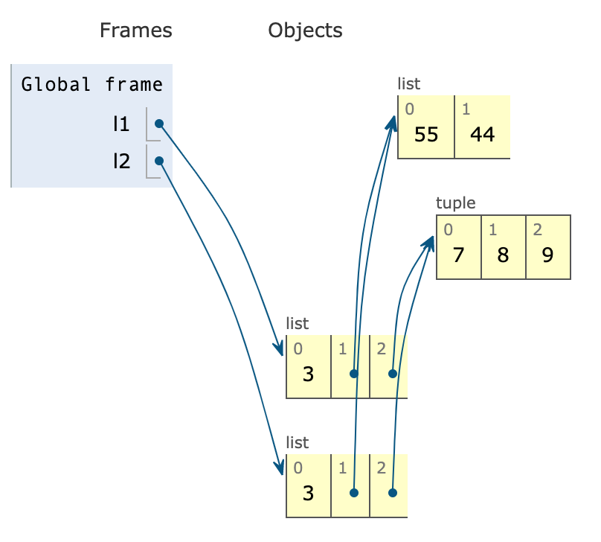
Shallow Copy
The easiest way to copy a list (or most built-in mutable collections) is to use the built-in constructor for the type itself. For lists and other mutable sequences, the shortcut l2 = l1[:] also makes a copy.
However, using the constructor or [:] produces a shallow copy (i.e., the outermost container is duplicated, but the copy is filled with references to the same items held by the original container).
This saves memory and causes no problems if all the items are immutable. But if there are mutable items, this may lead to unpleasant surprises.
l1 = [3, [55, 44], (7, 8, 9)]
l2 = list(l1)
print(l2 == l1)
print(l2 is l1)
# Output
True
False

Slide 72
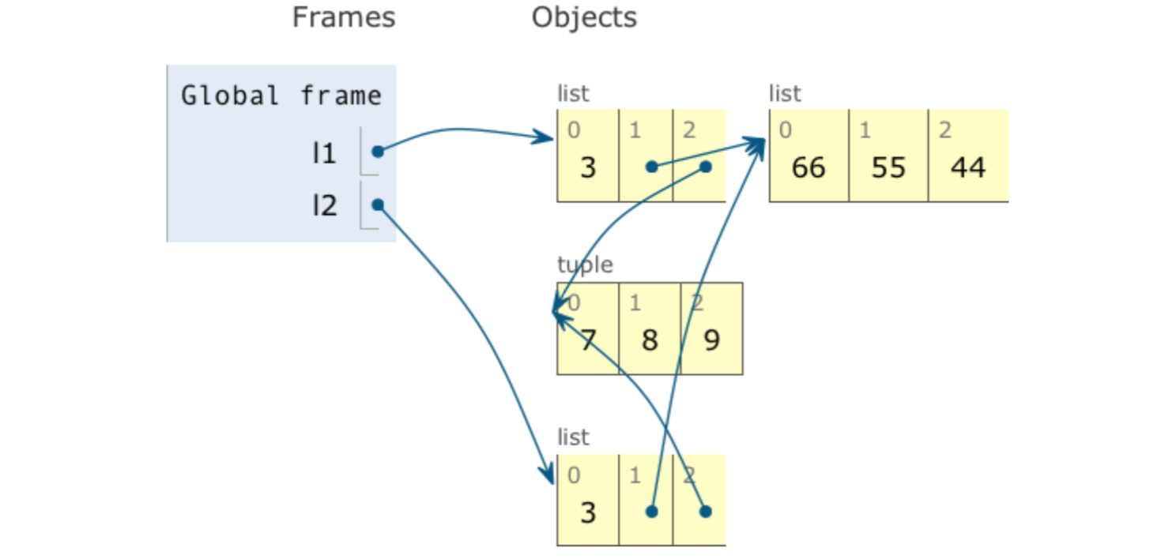
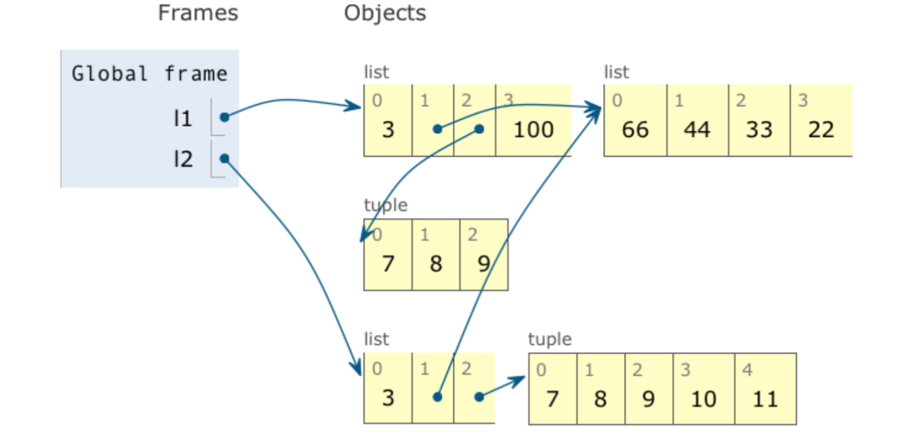
Shallow Copy
l1 = [3, [66, 55, 44], (7, 8, 9)]
l2 = list(l1)
print('l1:', l1)
print('l2:', l2)
l1.append(100)
l1[1].remove(55)
l2[1] += [33, 22]
l2[2] += (10, 11)
print('l1:', l1)
print('l2:', l2)
# Output
l1: [3, [66, 55, 44], (7, 8, 9)]
l2: [3, [66, 55, 44], (7, 8, 9)]
l1: [3, [66, 44, 33, 22], (7, 8, 9), 100]
l2: [3, [66, 44, 33, 22], (7, 8, 9, 10, 11)]

Slide 73
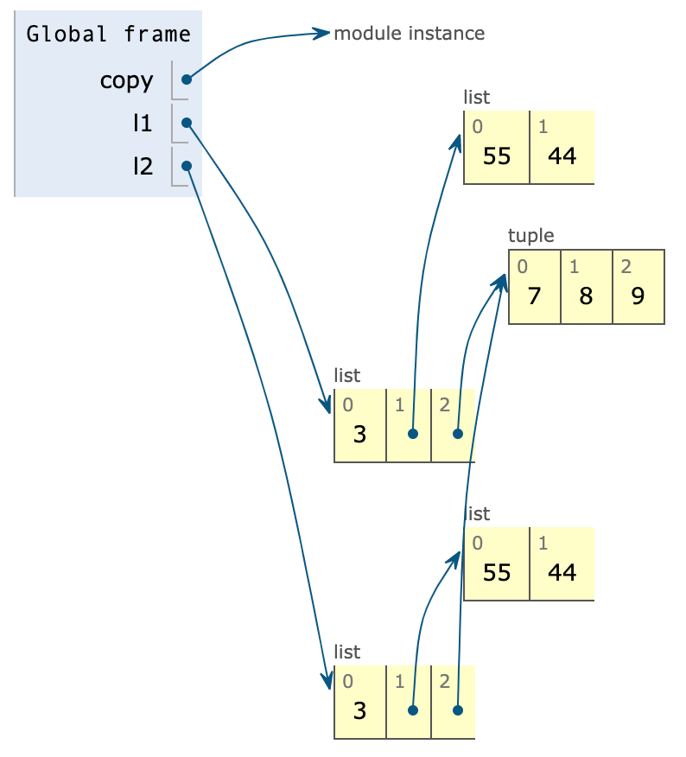
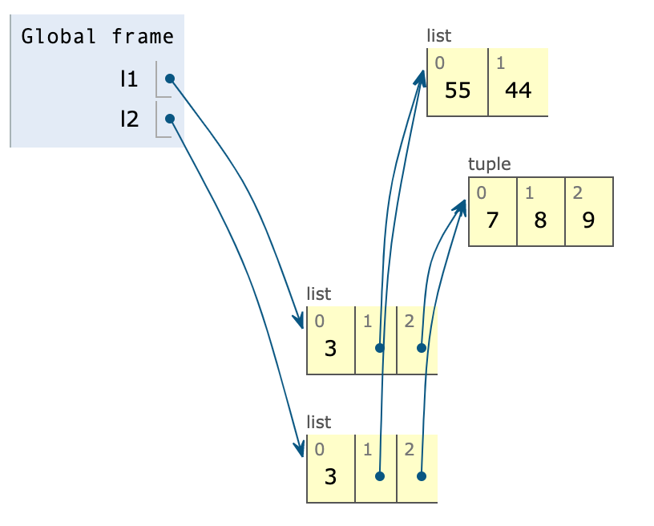
Deep Copy
l1 = [3, [55, 44], (7, 8, 9)] l2 = list(l1) print(l2 == l1) print(l2 is l1)
# Output
True
False
import copy
l1 = [3, [55, 44], (7, 8, 9)]
l2 = copy.deepcopy(l1)
print(l2 == l1)
print(l2 is l1)
# Output
True
False

